Slide 1

Public Offering Data Analysis
John-Paul Besong,Dounglan Cheung,Mario Garcia, Jeremy Gavrilov, Zachary Pinter

Slide 2
Overall Concept
Impact of Covid-19 on Global Business.
Using Sentiment Analysis to predict fluctuations in stock pricing. Focusing on:
Tweets about specific companies.
Trending words when stocks spike up/down.
Correlation with these and stock prices.

Slide 3



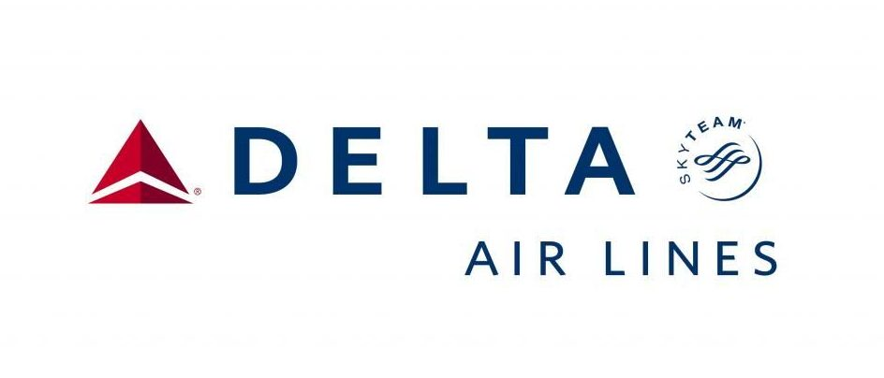
The Chosen Ones: NFLX, Zm, DAL, AAL
Airlines:
Deeply impacted by travel bans.
Zoom University
Meteoric rise in online classes.
Rise regardless of alleged privacy concerns.
Netflix
Higher percentage of free time due to quarantine
These companies have been the most trending, leading to the most Twitter data.

Slide 4
The numbers

